Slide 1

Codecademy Data Visualization Project

Slide 2
Project Outline
Kiva is a non-profit microfinancing company that award loans for projects in developing countries
This presentation showcases my visualizations of a dataset from Kaggle on Kiva’s loans in 5 different countries, an exercise set on Codecademy’s Data Science course
All visualizations were created using Seaborn and this project aims to convey how different plot types can lead to deeper/different insights

Slide 3
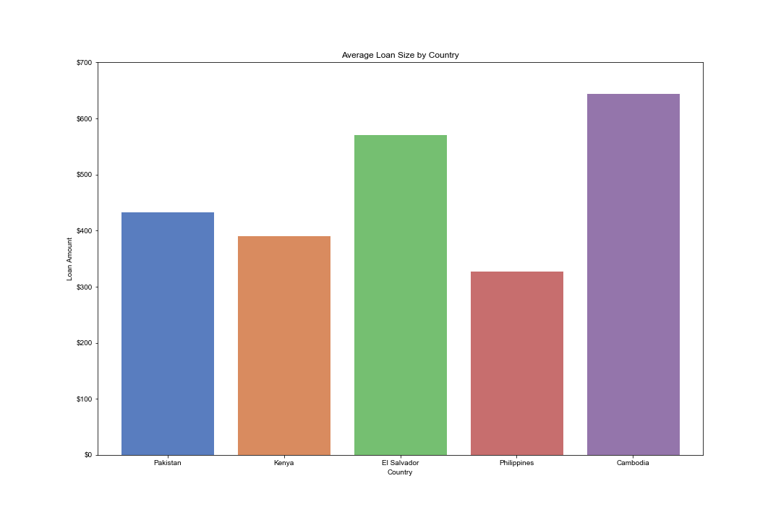
Average Loan Amounts by Country: 1
This bar chart shows the average loan amounts awarded by Kiva in 5 different countries
Cambodia’s average is the highest at just over twice that of the Philippines
There is little other insight that can be derived from this visualization

Slide 4
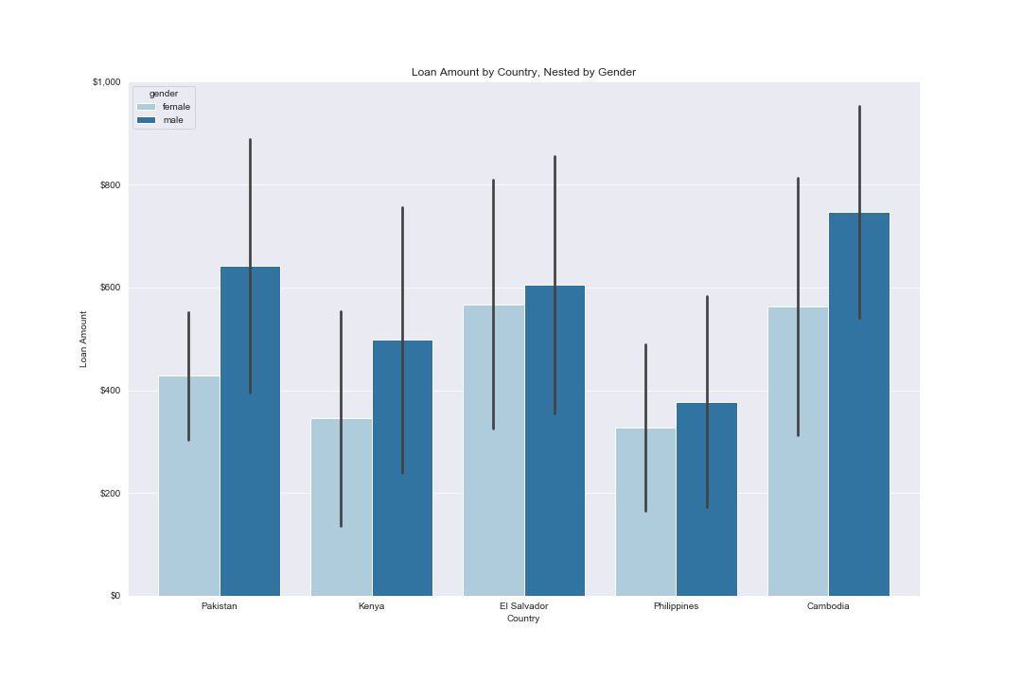
Average Loan Amounts by Country: 2
This chart adds two dimensions
It shows averages for males and females separately in each country
A clear gender disparity can be seen in Pakistan, Kenya and Cambodia that favours males
There is also disparity in El Salvador and the Philippines in the same direction, however it is significantly smaller
Error bars are set to show the range of one standard deviation
Assuming a normal distribution, these should give an idea of the range of roughly 65% of loans

Slide 5
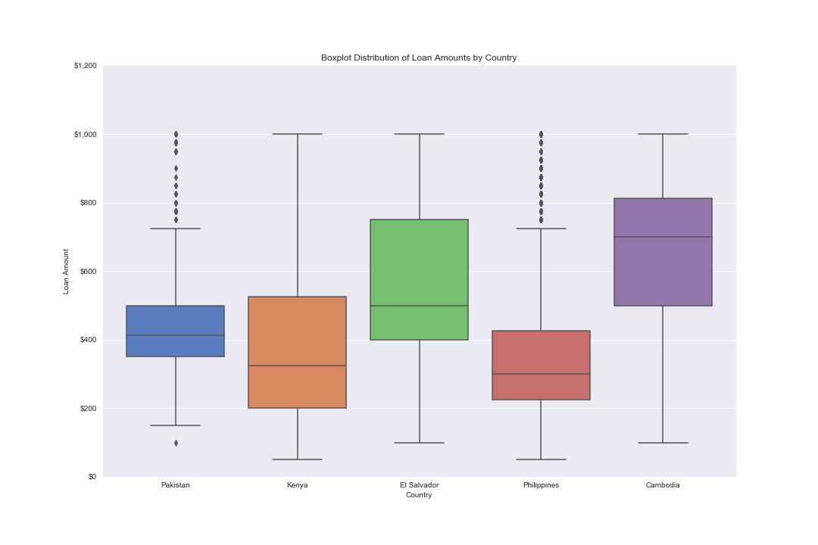
Average Loan Amounts by Country: 3
This boxplot focuses more on distribution
The central line of each box represents the median, the top and bottom edges represent the interquartile range
The ‘whiskers’ show the range of the rest of the distribution, except for outliers, which are shown by the dots
From this visualization, we can see that the majority of Kenya, El Salvador and Cambodia’s loans vary the most widely
El Salvador and Cambodia’s interquartile ranges stick out as being greater than those of the other 3 countries

Slide 6
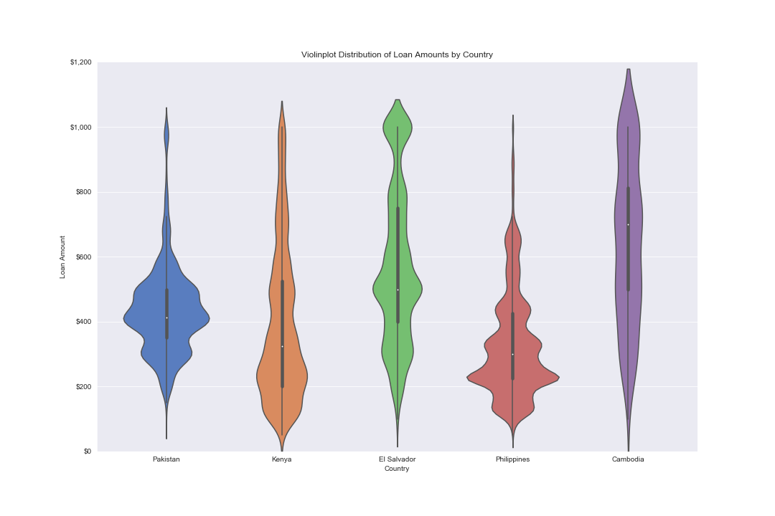
Average Loan Amounts by Country: 4
A violinplot displays the data similarly:
The line in the centre of each ‘violin’ extends to the same length of the boxplot’s ‘whiskers’
The thicker area of the line represents the interquartile range and the white dot represents the median
However, this version graphs the distributions more homogenously, allowing for further inferences:
Cambodia’s loans most evenly distributed
Humps in Pakistan and the Philippines’ distributions suggest that their offices could have more defined categories for the figures
Kenya’s weighted towards the lower end
El Salvador’s loans for the most part distributed evenly, but there is a bubble at the top around the $1000 mark

Slide 7
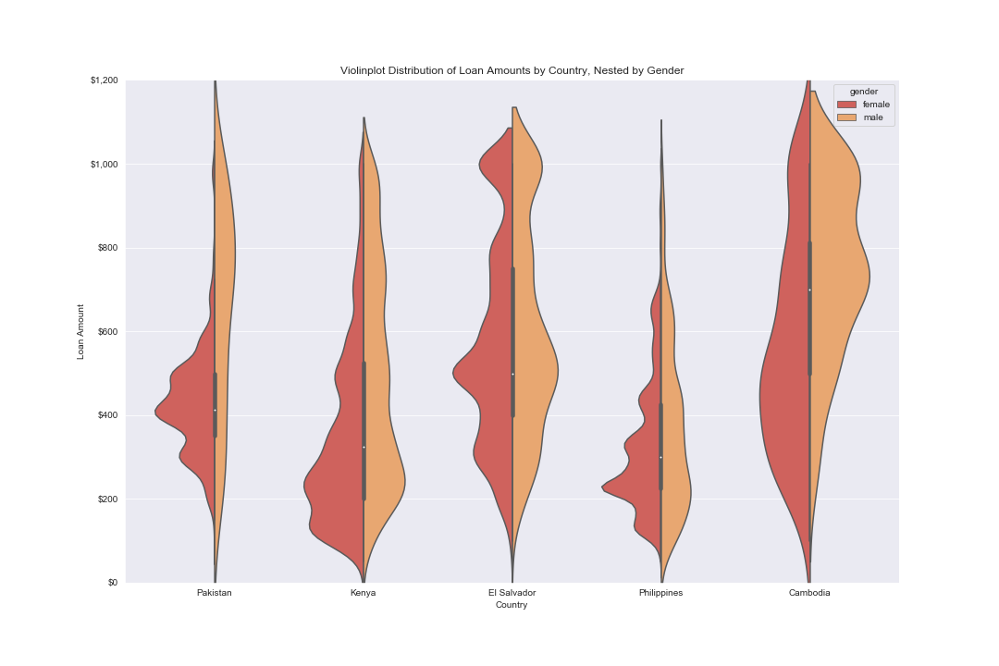
Average Loan Amounts by Country: 5
This is the same violinplot, except nested once again by gender
Although Pakistan, Kenya and Cambodia have similar disparities (as shown by the second bar chart), the higher number of loans in Cambodia amplifies this here
In all countries besides Cambodia, the distributions for loans to females have clearly defined humps, but not for males
E.g. In Pakistan, the majority of females seem to be awarded a loan of either around $300, $400 or $500
This may mean that the financial requirements of projects lead by males are more thoroughly calibrated, with females applications perhaps being processed less carefully and thrown into easy categories of frequently used or easily rounded figures

